Slide 1





How can geophysical imaging reveal Majada’s subsoil?
Benjamin Mary May 29th, Majadas’ workshop

Slide 2
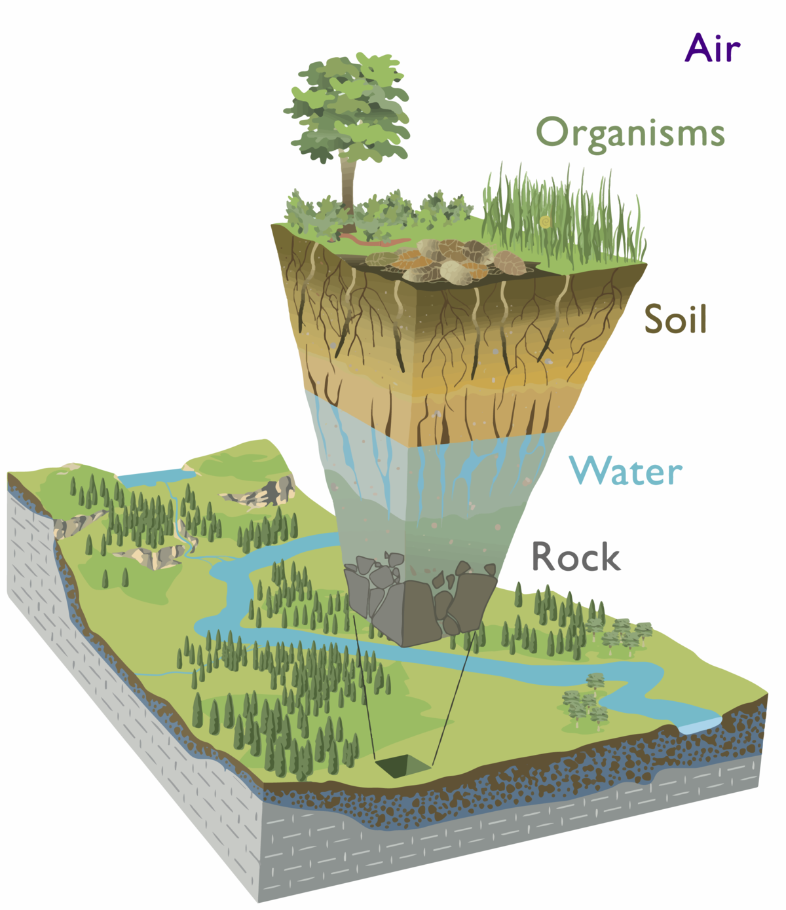
How water moves ?
Redistribution
Evapotranspiration
Rooting properties are often neglected due to lack of methods to measure
Channeling
Credit to Chorover et al. 2007.

Slide 3
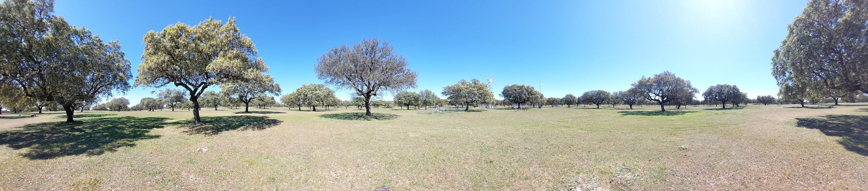
How water moves in Tree-Grass ecosystems?
Competition/collaboration between tree/grass
Seasonality of ET (senescence, …)
…
‹#›

Slide 4
Objectives
Impact of land use on water budgets?
2. Identify soil spatial heterogeneity with a focus on the soil water content
‹#›

Slide 5


Conceptual model
Water & energy
Hydraulic lift
Hydraulic lift
50 cm
SAND
Water retention
50 cm
CLAY
?
50 cm
SANDY CLAY
SANDY CLAY
Refs:
• Burchard-Levine et al, 2020. Seasonal Adaptation of the Thermal-Based Two-Source Energy Balance Model for Estimating Evapotranspiration in a Semiarid Tree-Grass Ecosystem. Remote Sensing, 12: 1-29.
• El-Madany et al., 2020. Drought and heatwave impacts on semi-arid ecosystems' carbon fluxes along a precipitation gradient. Philosophical Transactions R.Soc.B, 375: 1-9.
• Luo et al., 2020. Nutrients and water availability constrain the seasonality of vegetation activity in a Mediterranean ecosystem. Global Change Biology, 26: 4379-4400.
• Krich et al., 2020. Estimating causal networks in biosphere–atmosphere interaction with the PCMCI approach. Biogeosciences, 17: 1033-1061.
‹#›

Slide 6
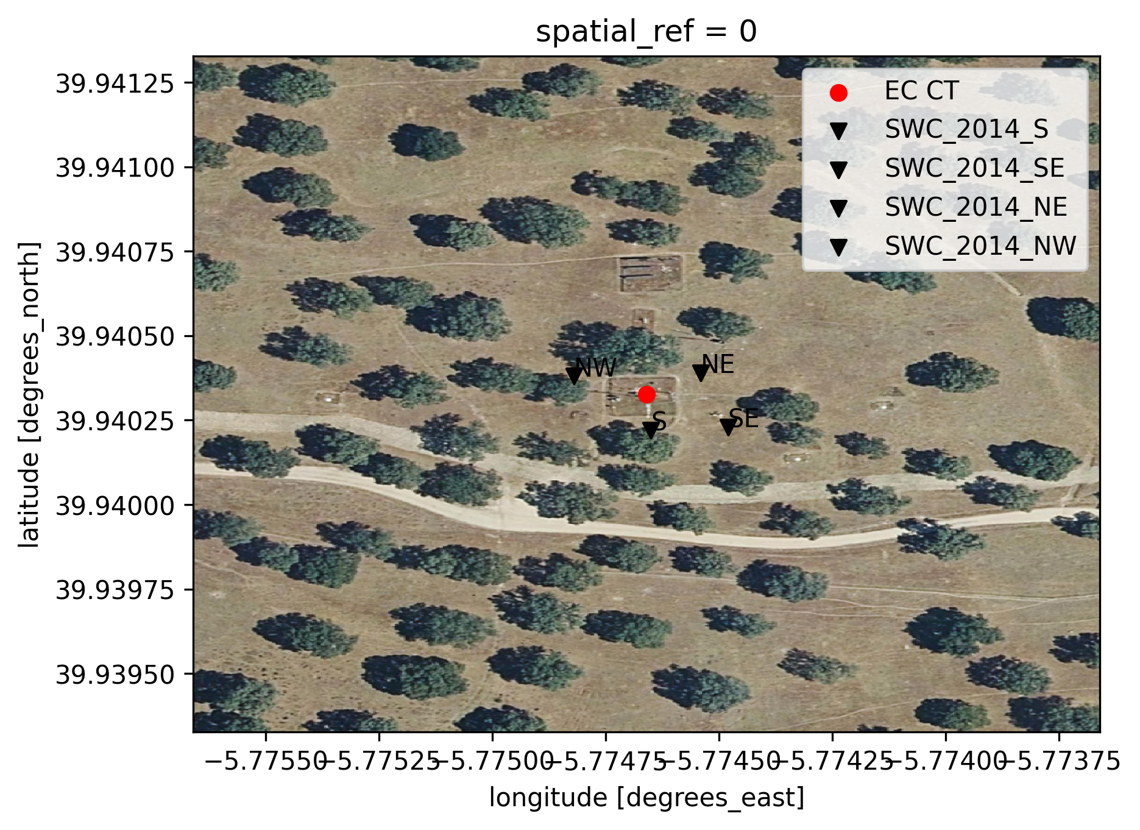
Soil Water Content Sensors
‹#›

Slide 7
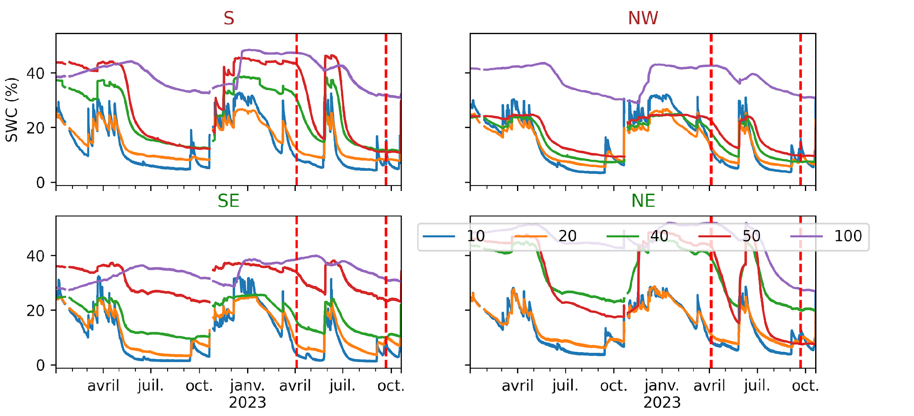
Soil Water Content
‹#›

Slide 8
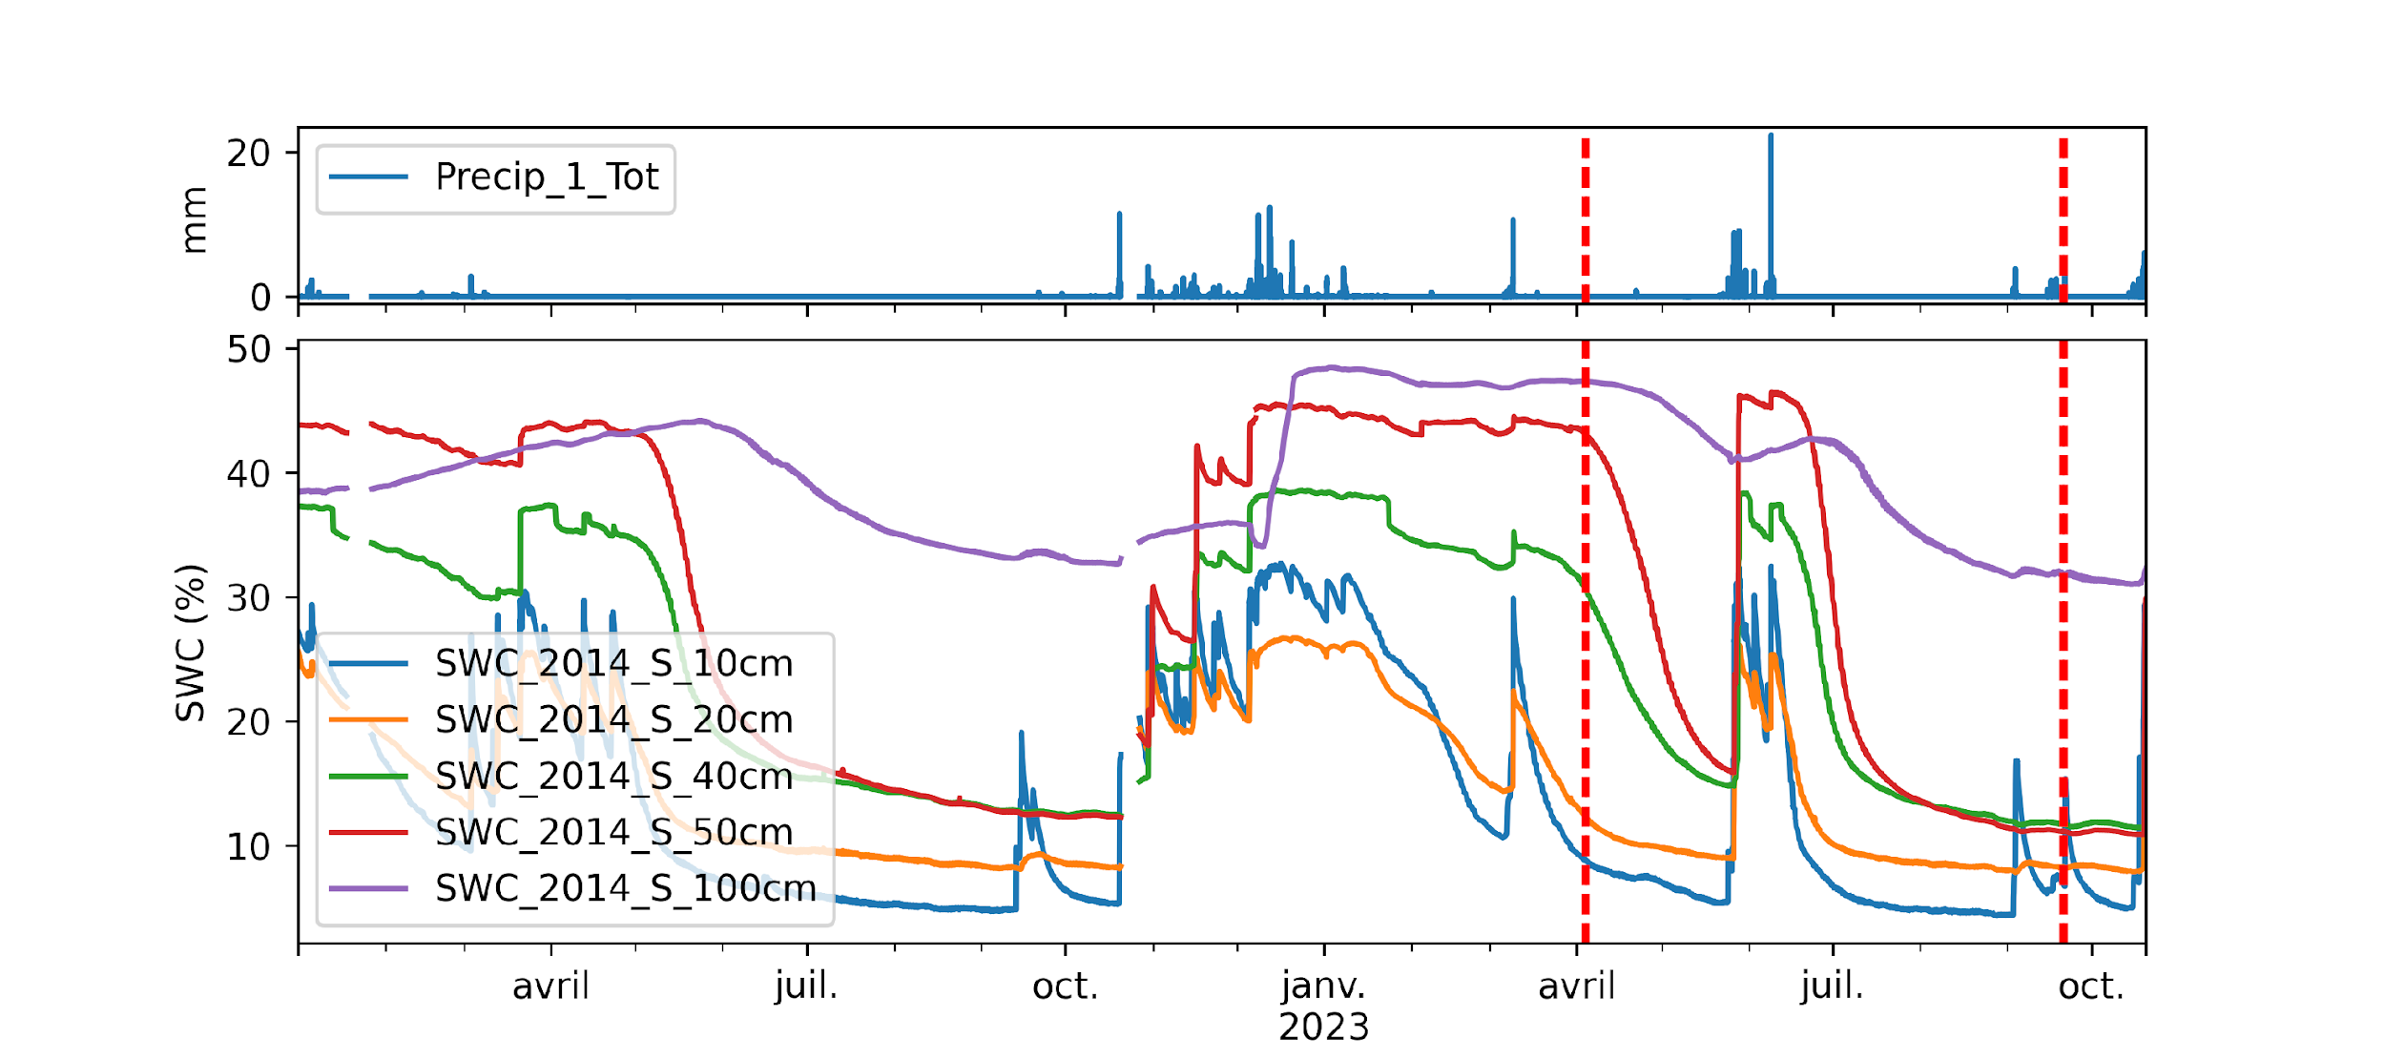
Soil Water Content
‹#›

Slide 9
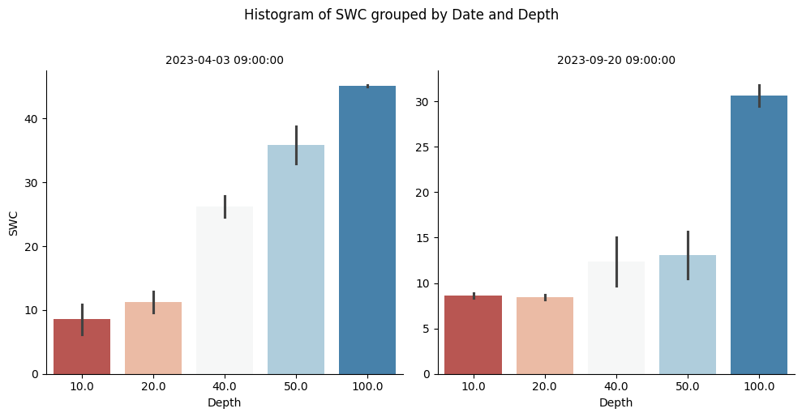
- Active soil depth is located at 50cm
- Below 1m, a “lot” of water is available all along the year
April
September
Vegetation effect
‹#›

Slide 10
Challenges
Does tree deep roots uplift water for grass?
Influence of the microtopography?
SWC sensors are punctual ….
Influence of the soil treatment?
How much the clay layer controls water retention?
‹#›

Slide 11
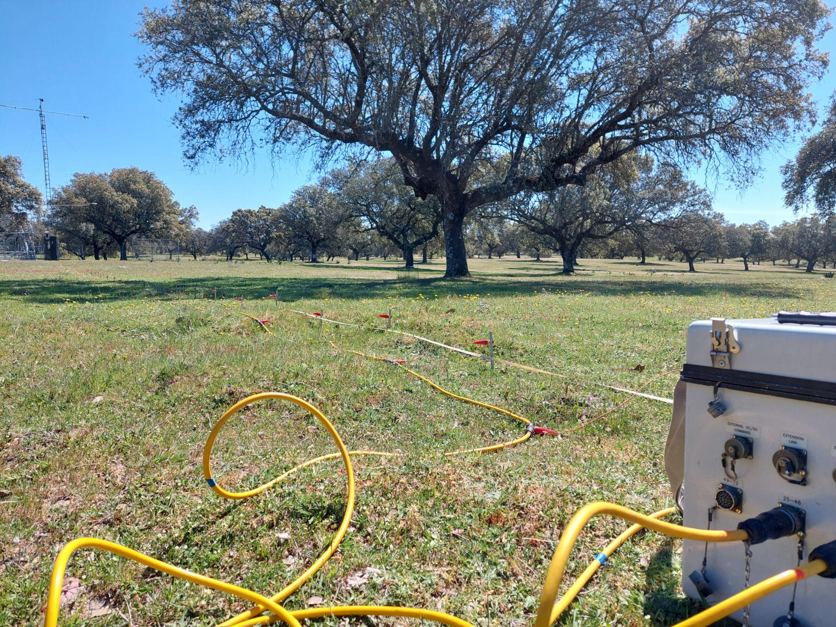
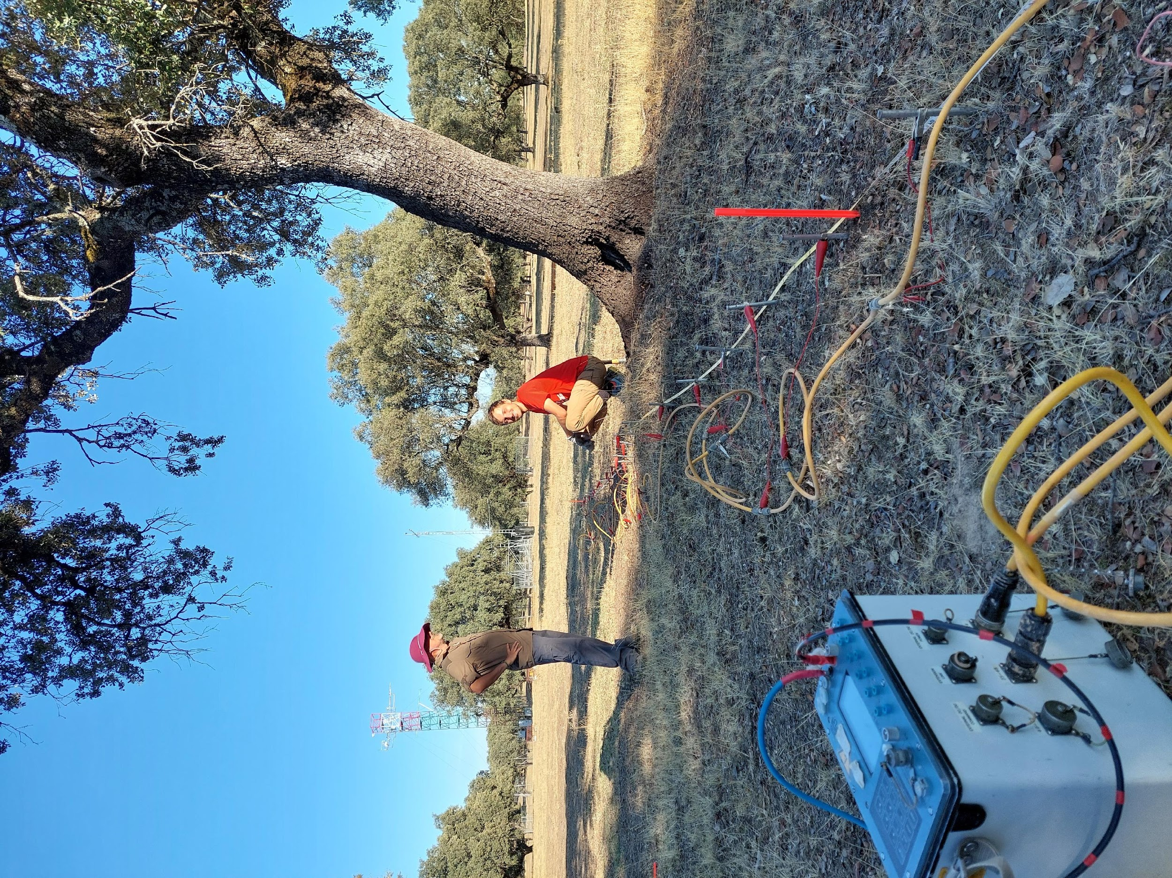
April & September 2023
‹#›

Slide 12
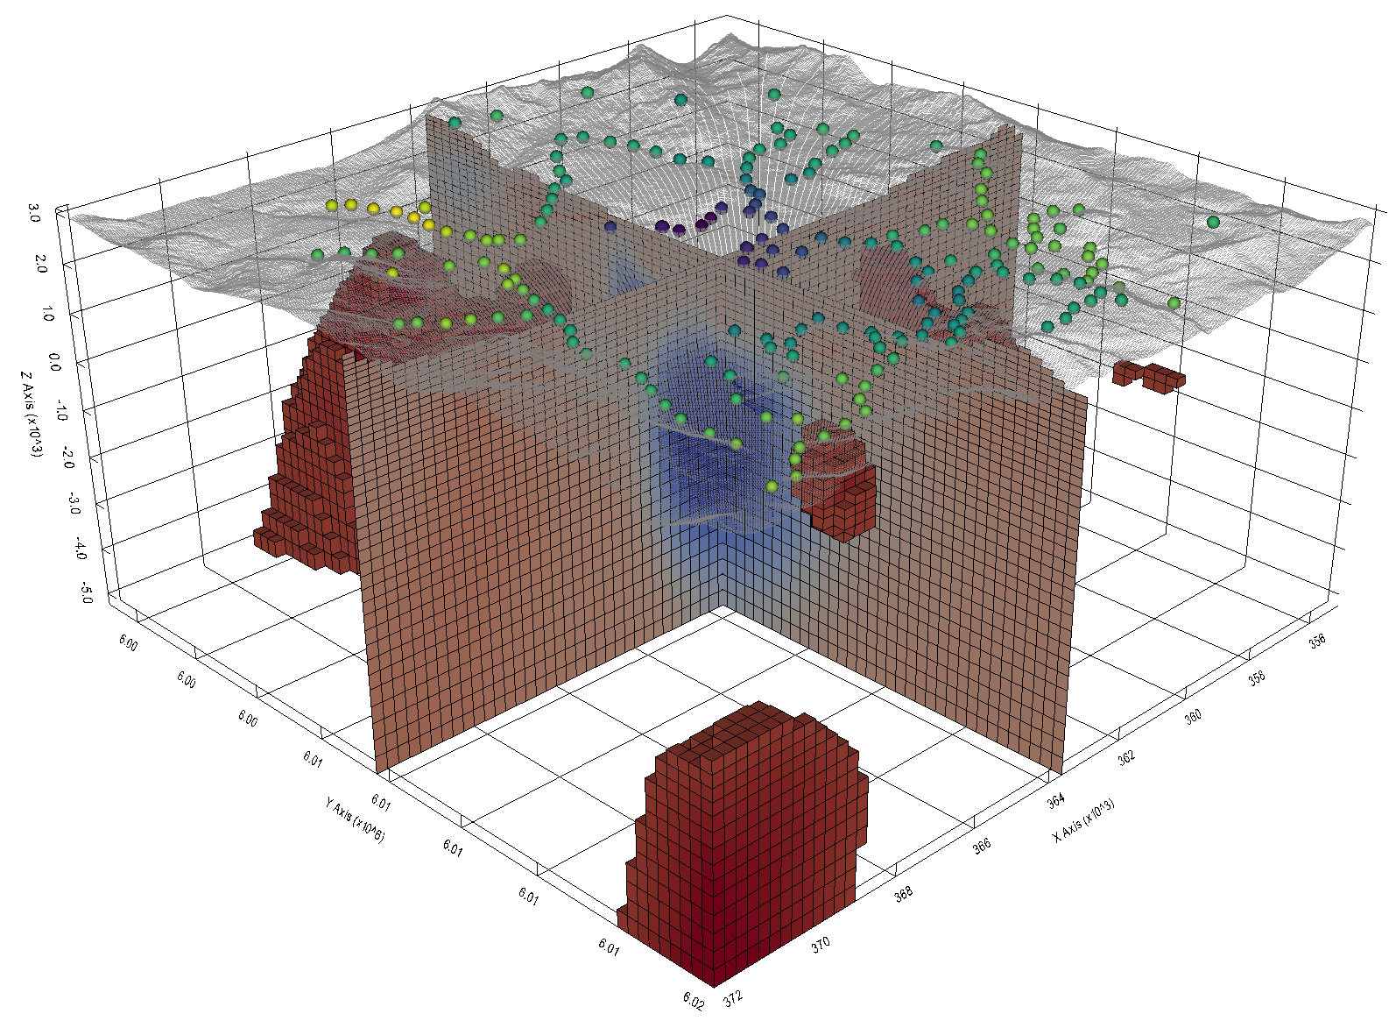
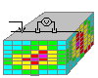
Why geophysics?
Credit to geosci.xyz
Field measurements
Raw data
Processing
(inversion)
‹#›
3D (+ time) physical property model

Slide 13
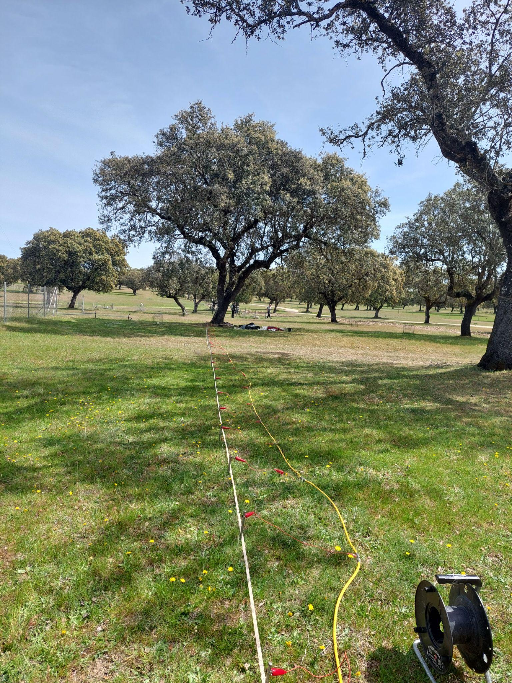
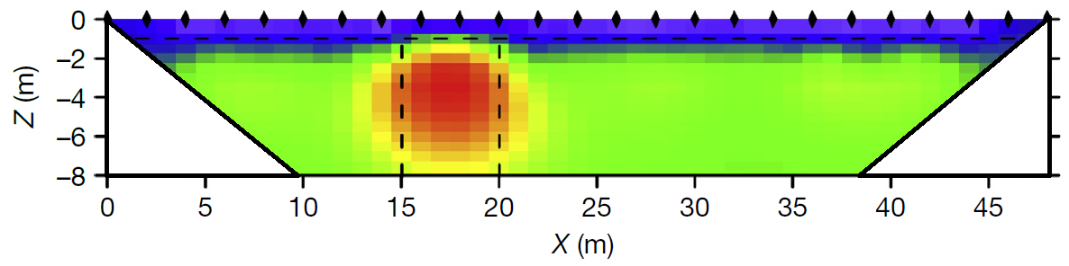
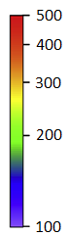

ERT (Electrical Resistivity tomography):
Depth of investigation: up to 6 meters
Lateral resolution: 0.25/0.5m
Resistivity model
𝜌 (Ωm)
X
ERT section
Z

Slide 14
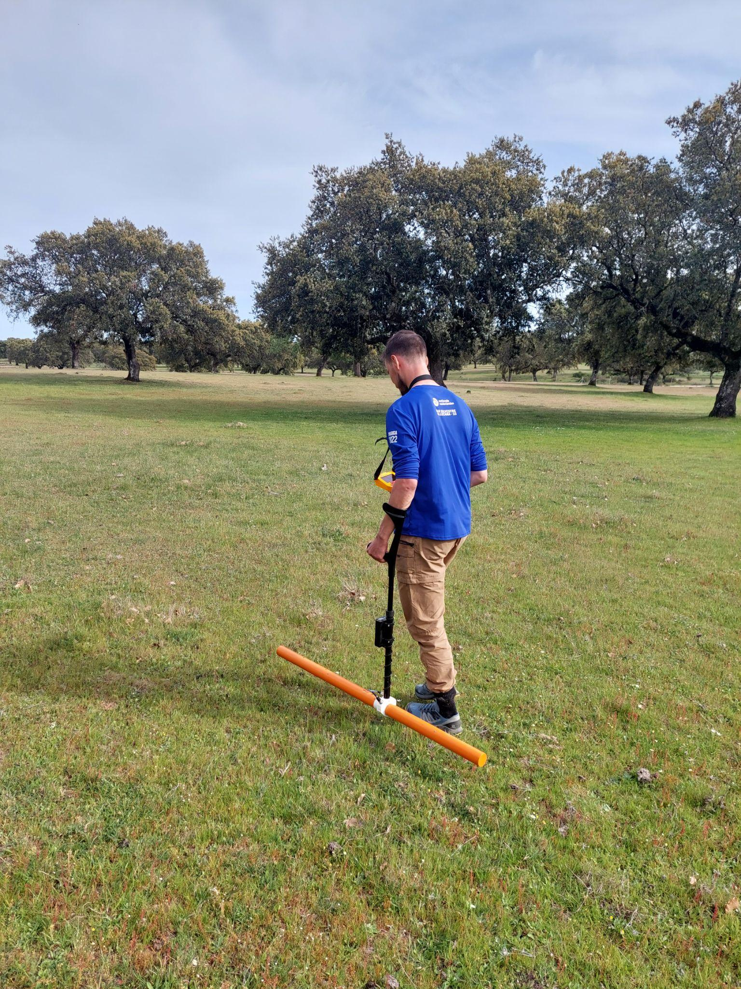
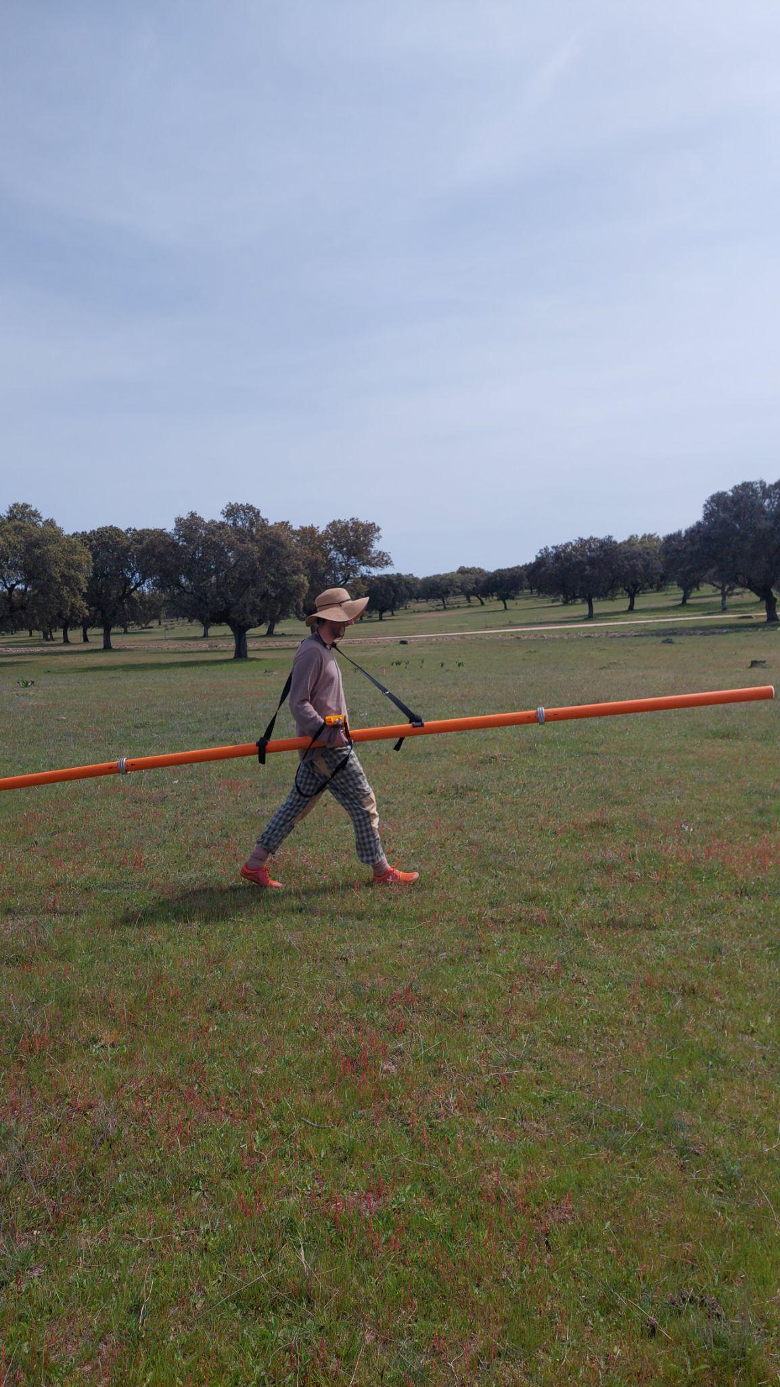
EM (Ground magneto-meter):
Depth of investigation: from 0.25 to 3 (0.25, 0.5, 0.9 & 1.1, 2.1, 3.3m)
Lateral resolution: up to 1m
Z
EM map
X

Slide 15
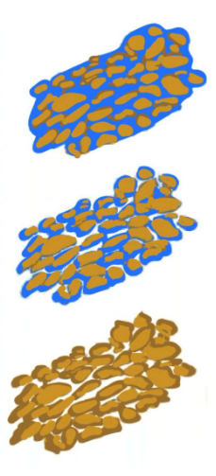
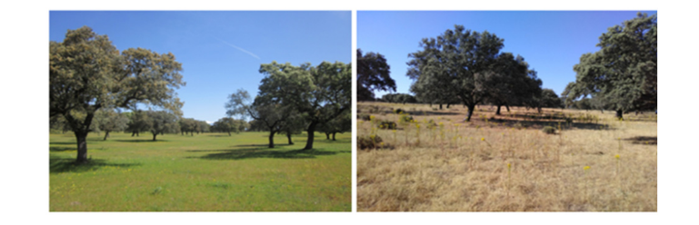
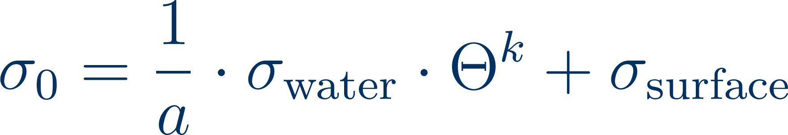

How to estimate clay content?
Θ is the soil water content
S is the saturation degree
Φ is the porosity
n, m a material constant
σ_{surface}, a and k are invariant vs season
~ clay content

Slide 16

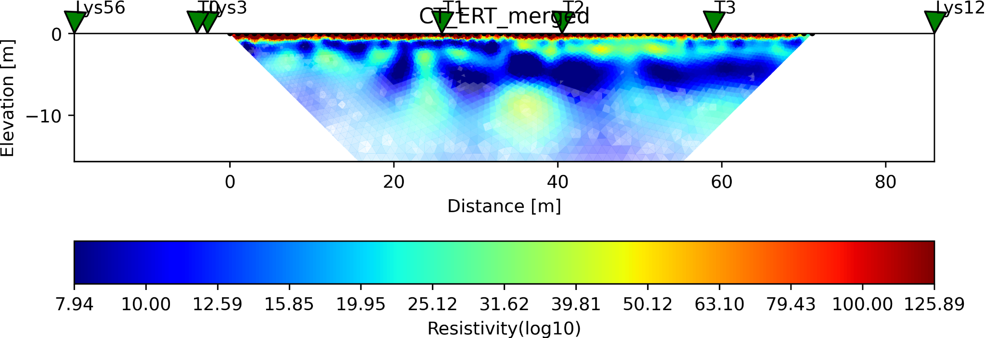
April 2023
Control
Tower
Clay layer
‹#›

Slide 17
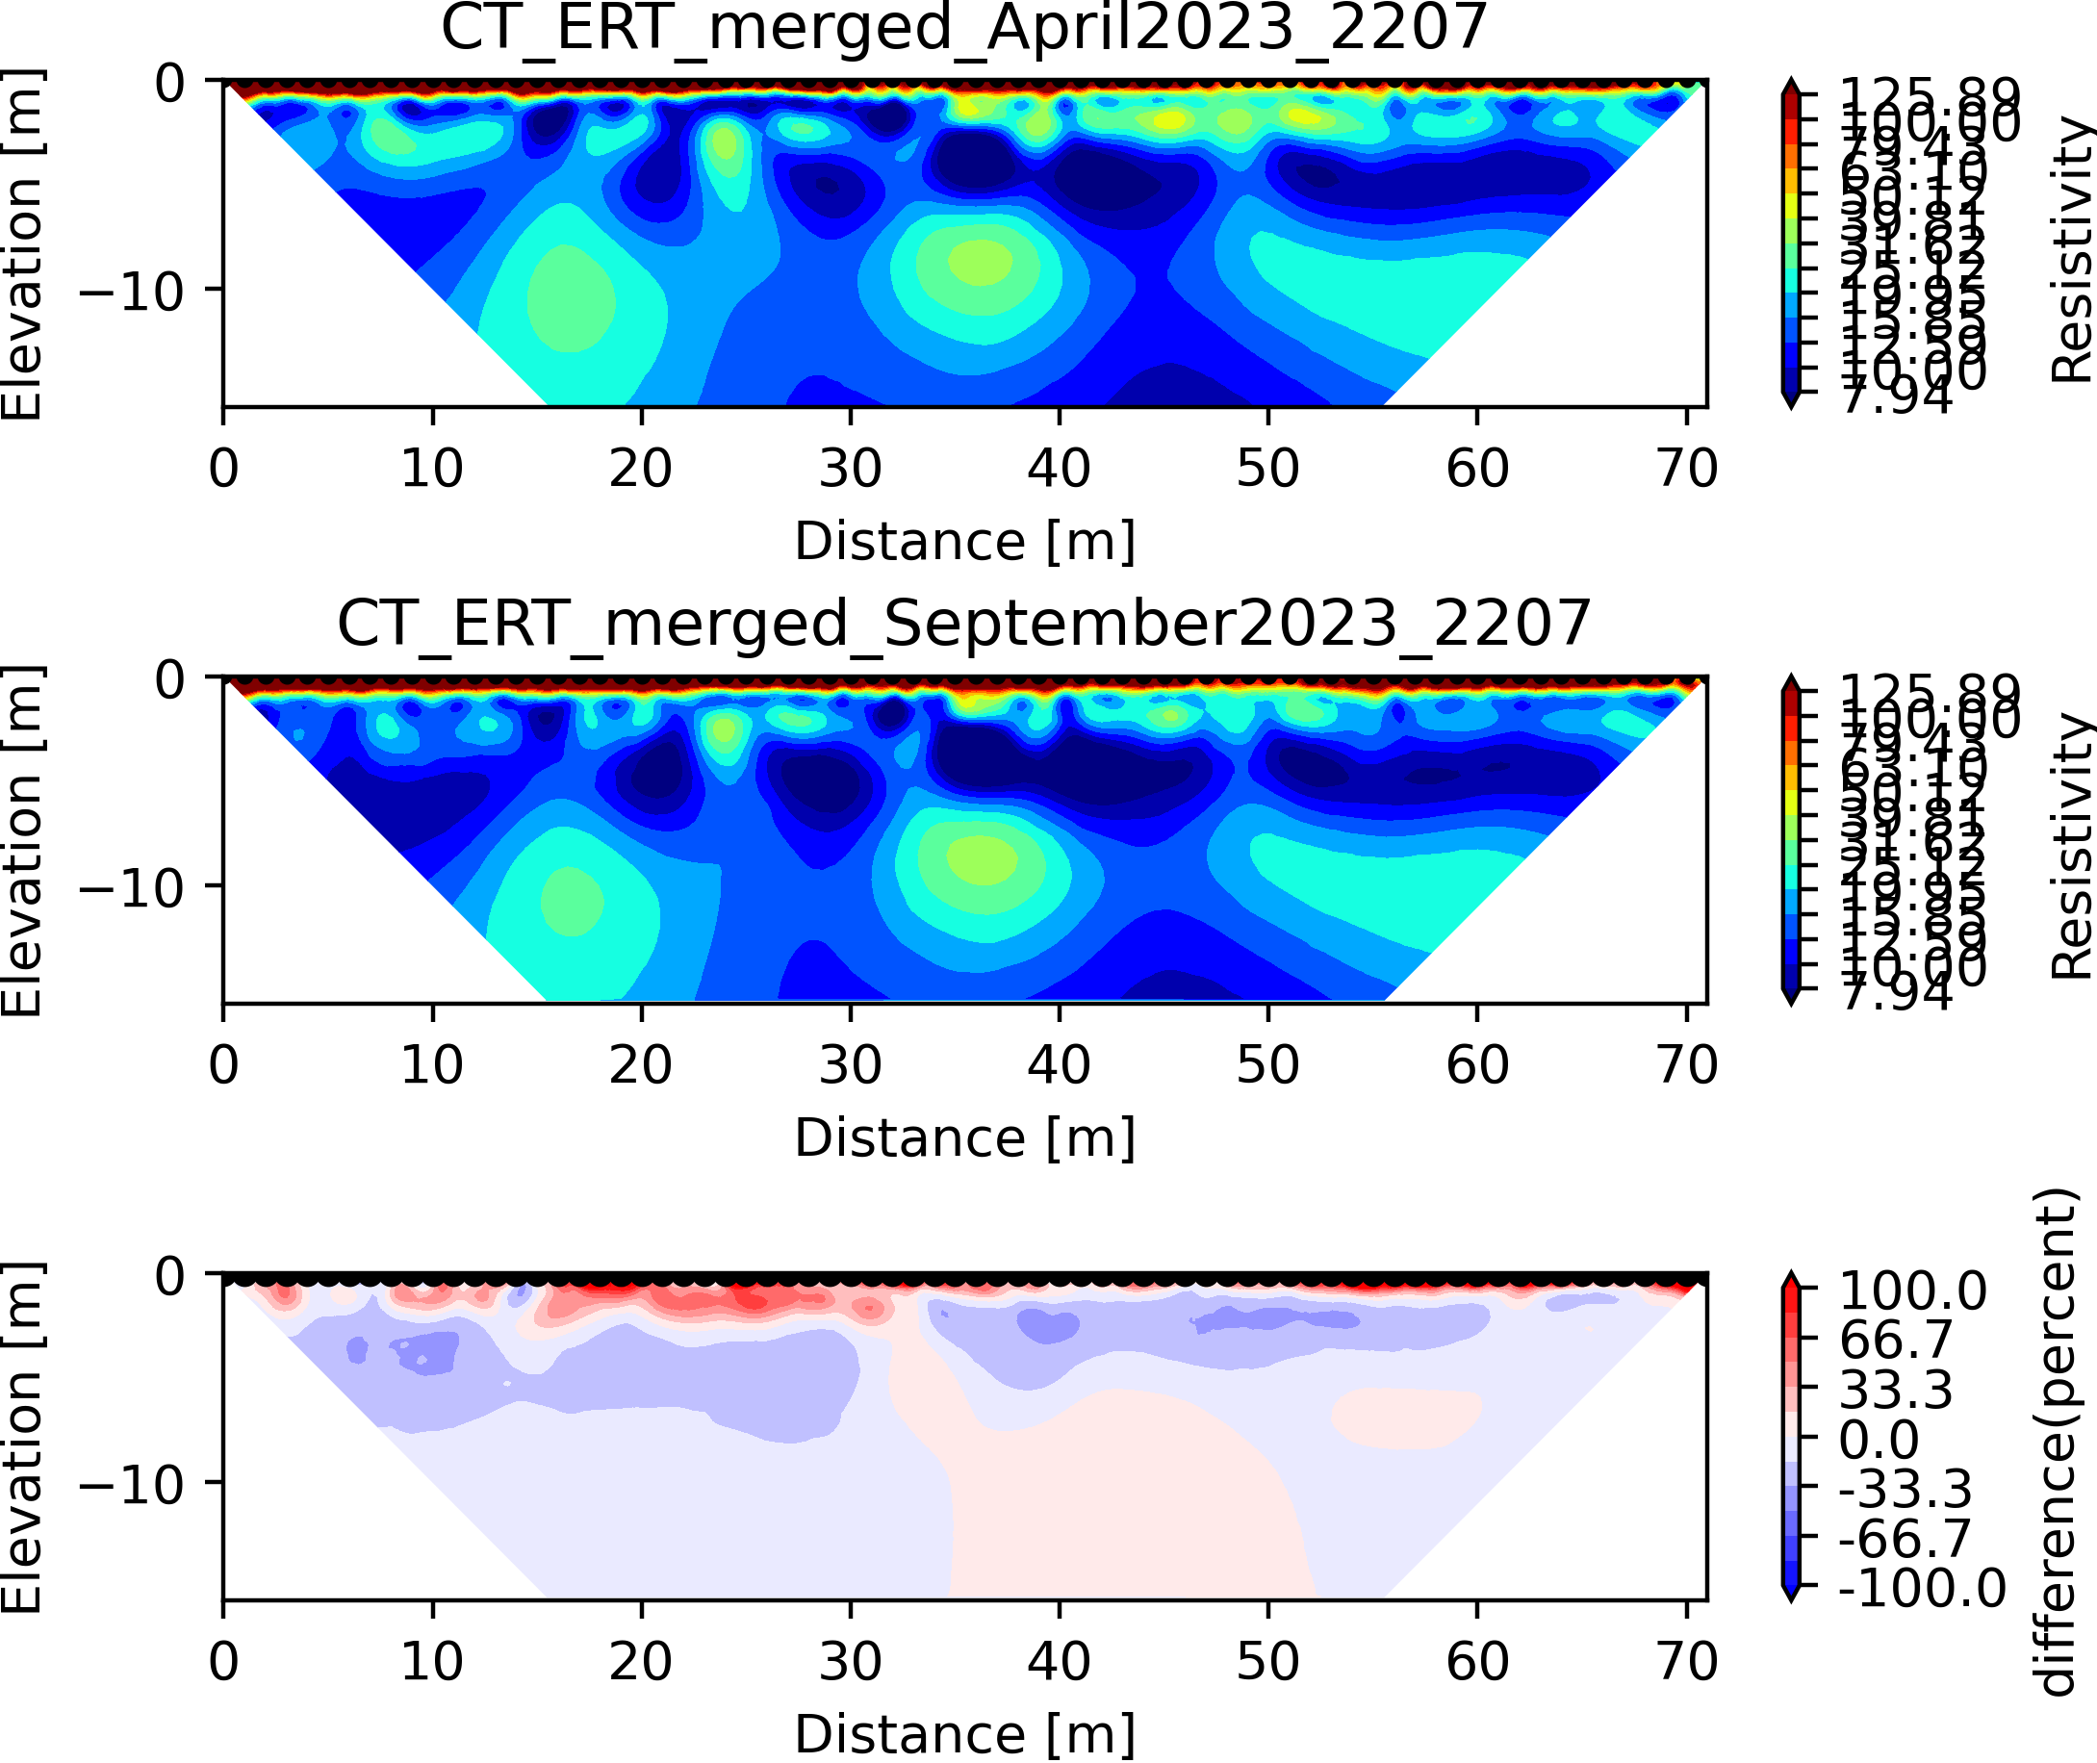
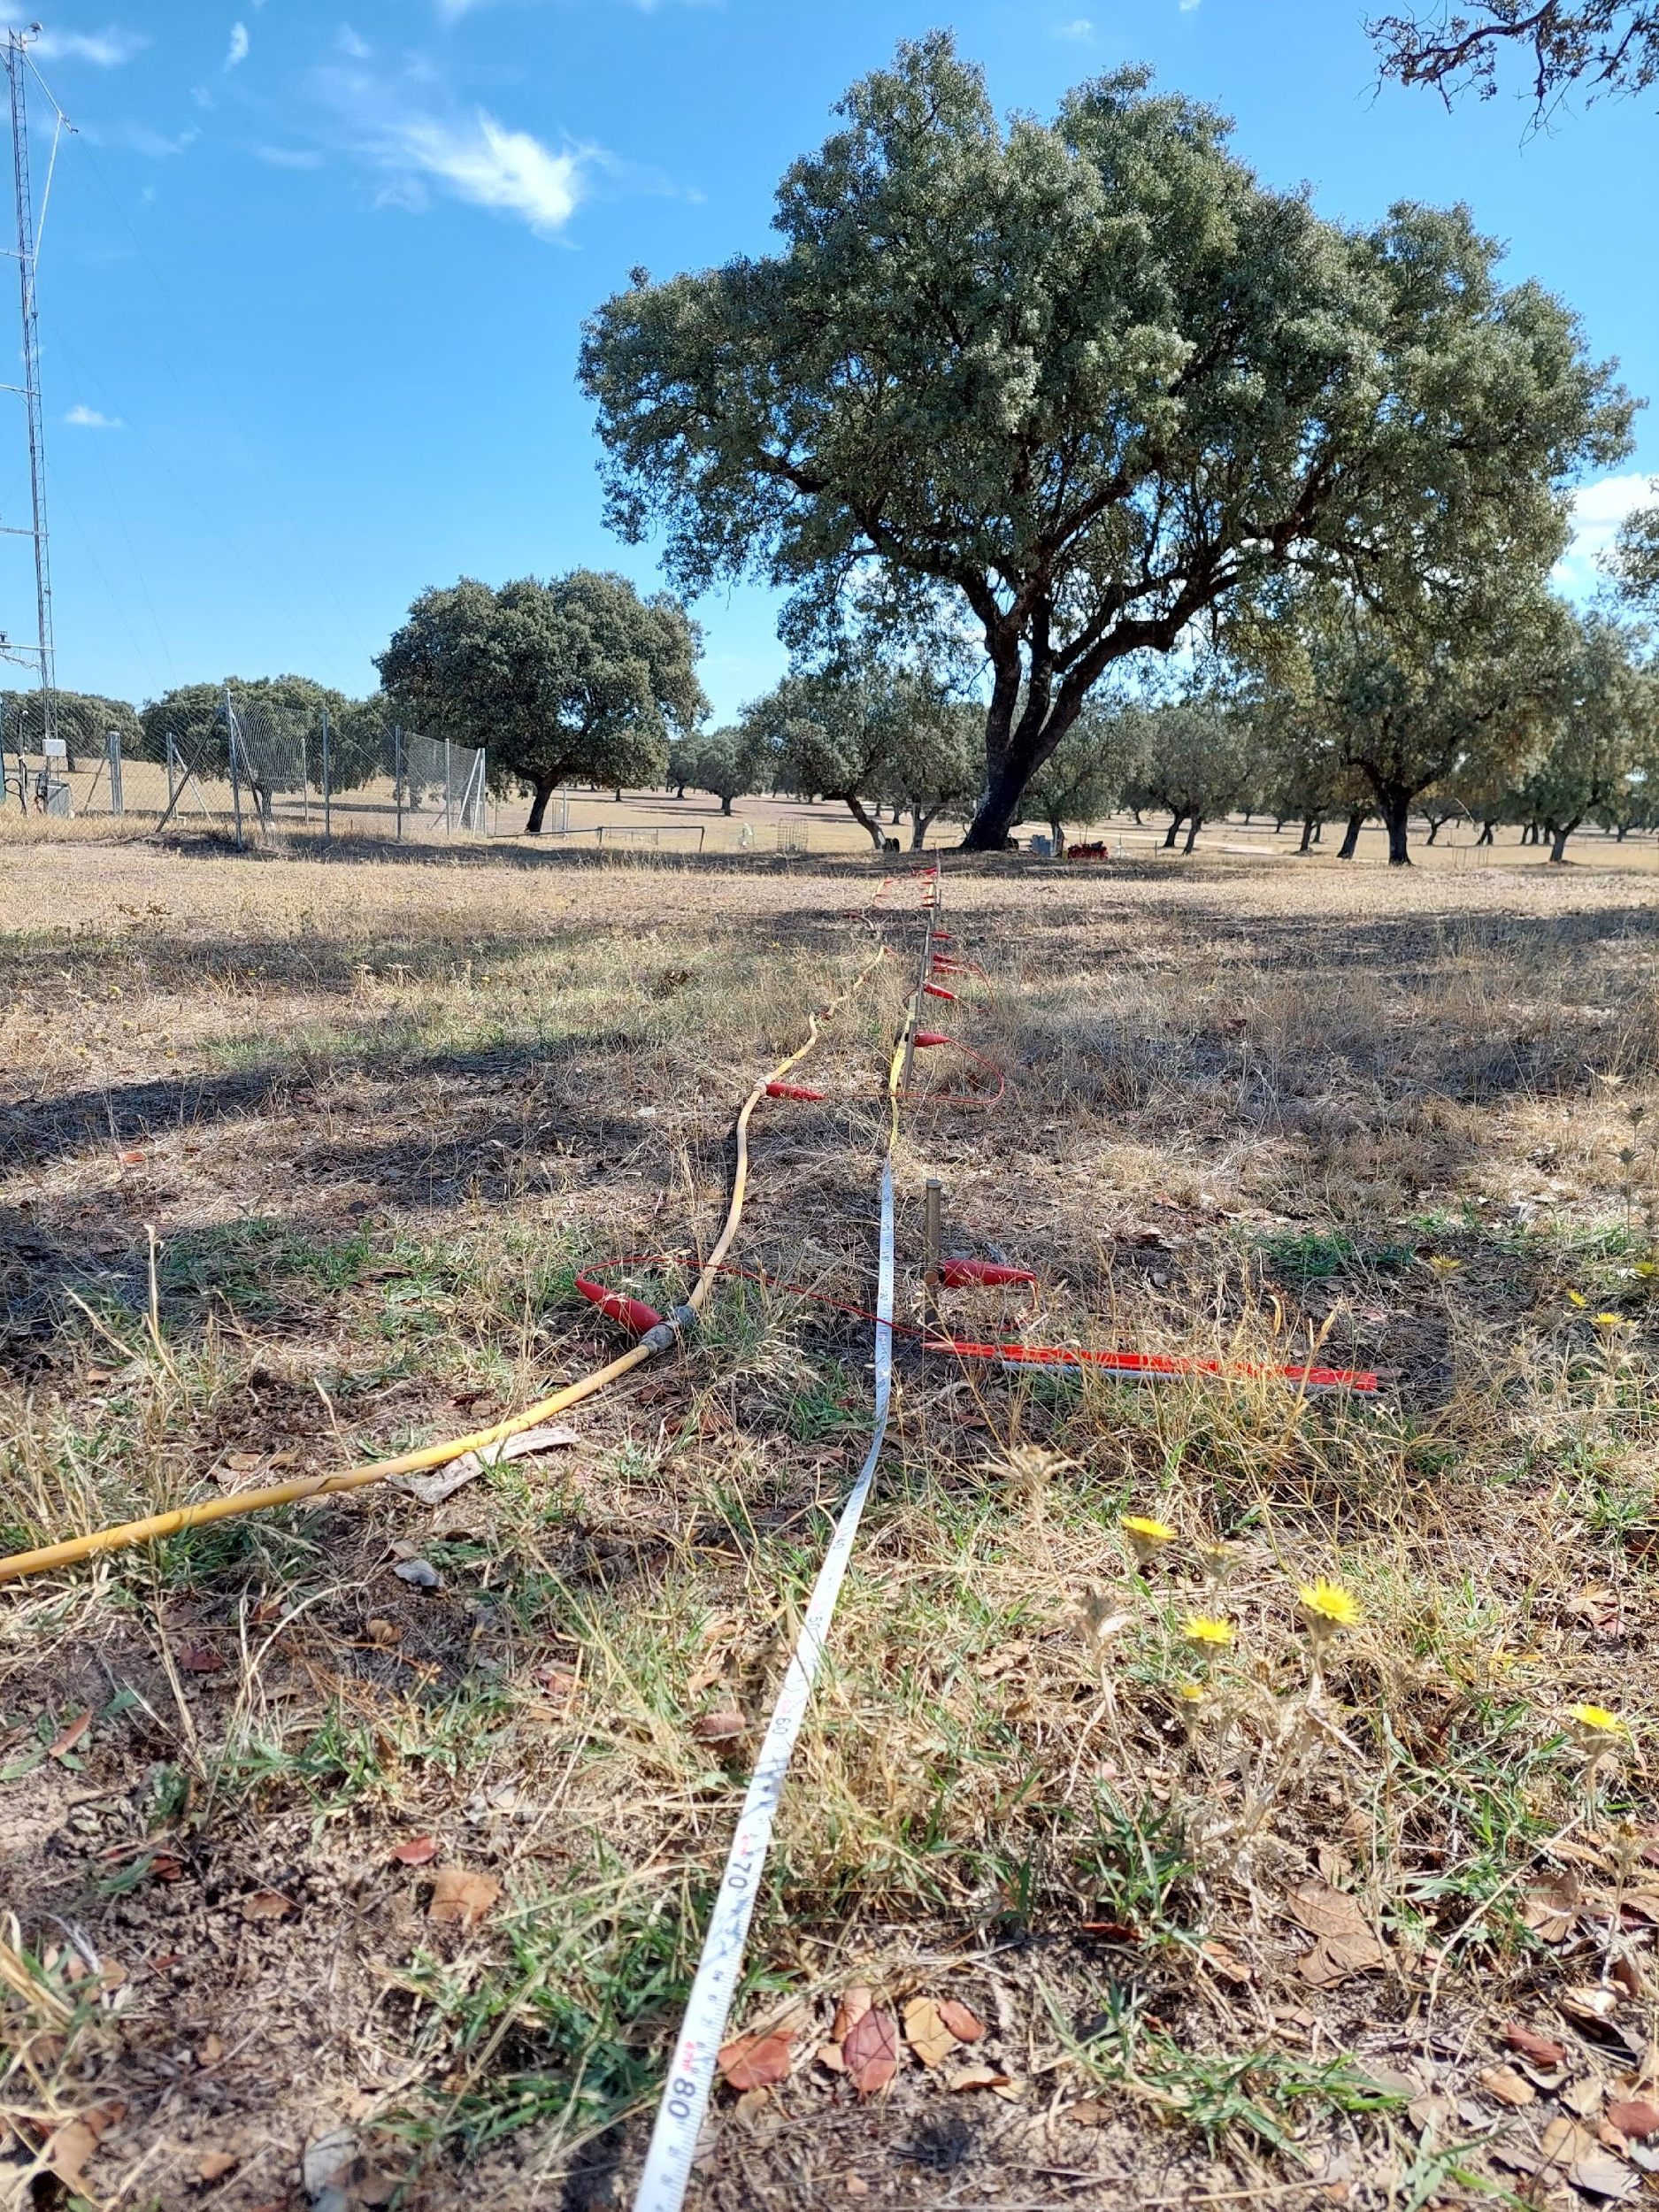
Control
Tower
‹#›

Slide 18
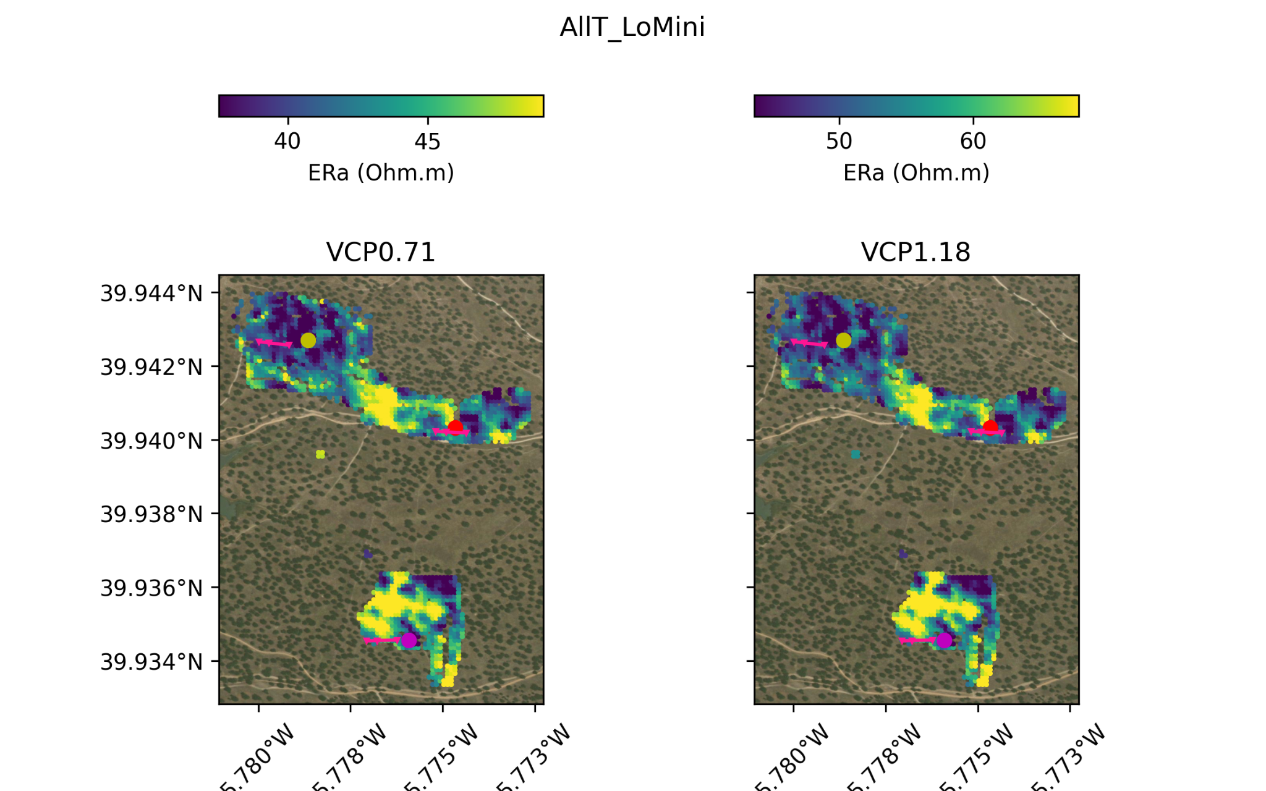
September 2023
Paleochannels (soil compaction), soil clay >> NP treatments
‹#›

Slide 19
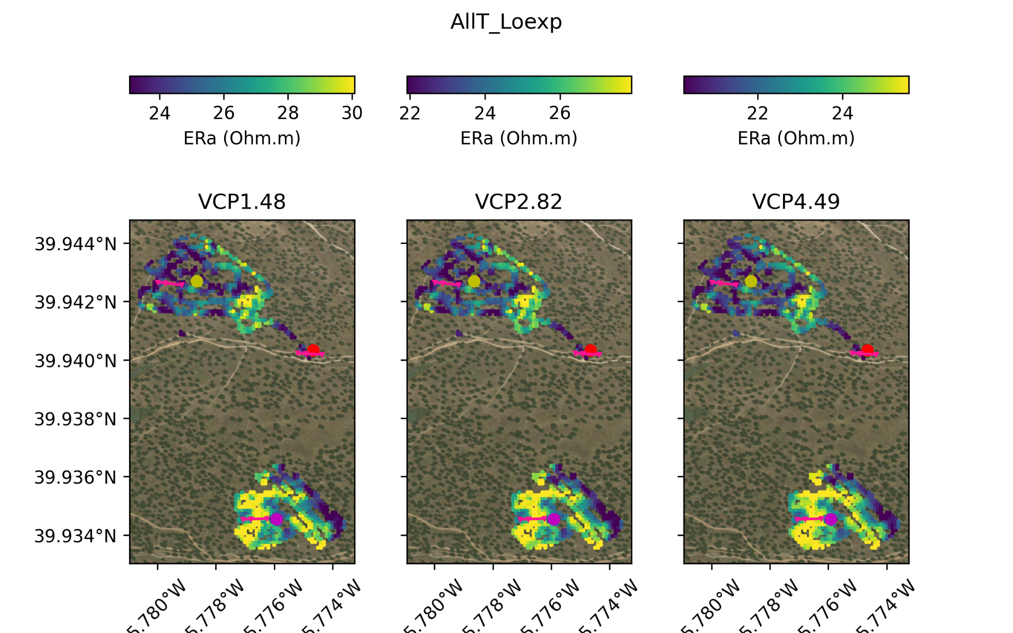
September 2023
Depth (m)
0.5
0.9
1.1
2.1
3.3
More conductive soil for the North tower than for the Nitrogen one
‹#›

Slide 20
Revised conceptual model: clay discontinuity
Paleochannels (?) / roads
SAND
CLAY
SAND
BEDROCK

Slide 21
On-going work
Translate electrical conductivity → soil water content/potential/clay content
Article redaction: “Exploring the soil water dynamics of a semi-arid tree-grass ecosystem through geophysical methods”
Repeat field work with a better resolution (focusing on a 2/3 trees)
2bis: install permanent tomography line
Water balance modeling → hydraulic conductivity
‹#›

Slide 22




Acknowledgements
CSIC: Hector, Vicente, Pilar, Gustavo, Christina …
CU Plasencia: G. M. Marcos
UNIPD: L. Peruzzo
UB: R. Lovera, A. Casas (Instrumentation)
…

Slide 23
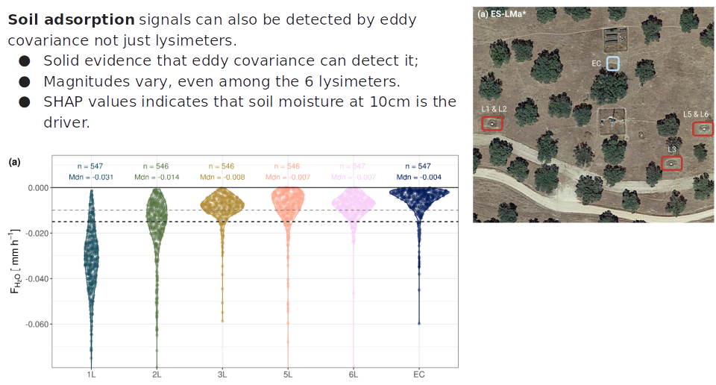

Slide 24
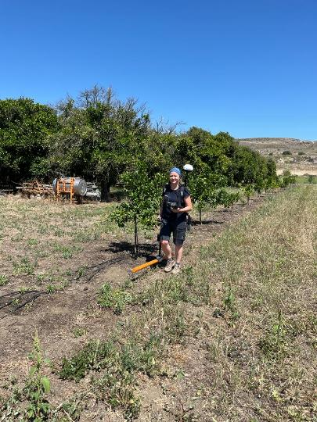
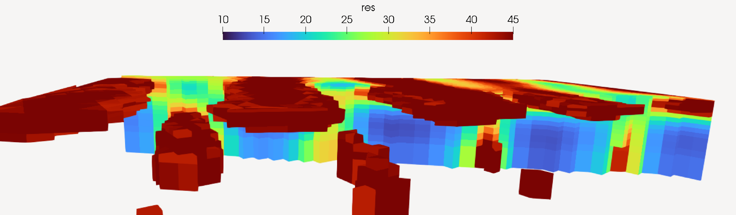
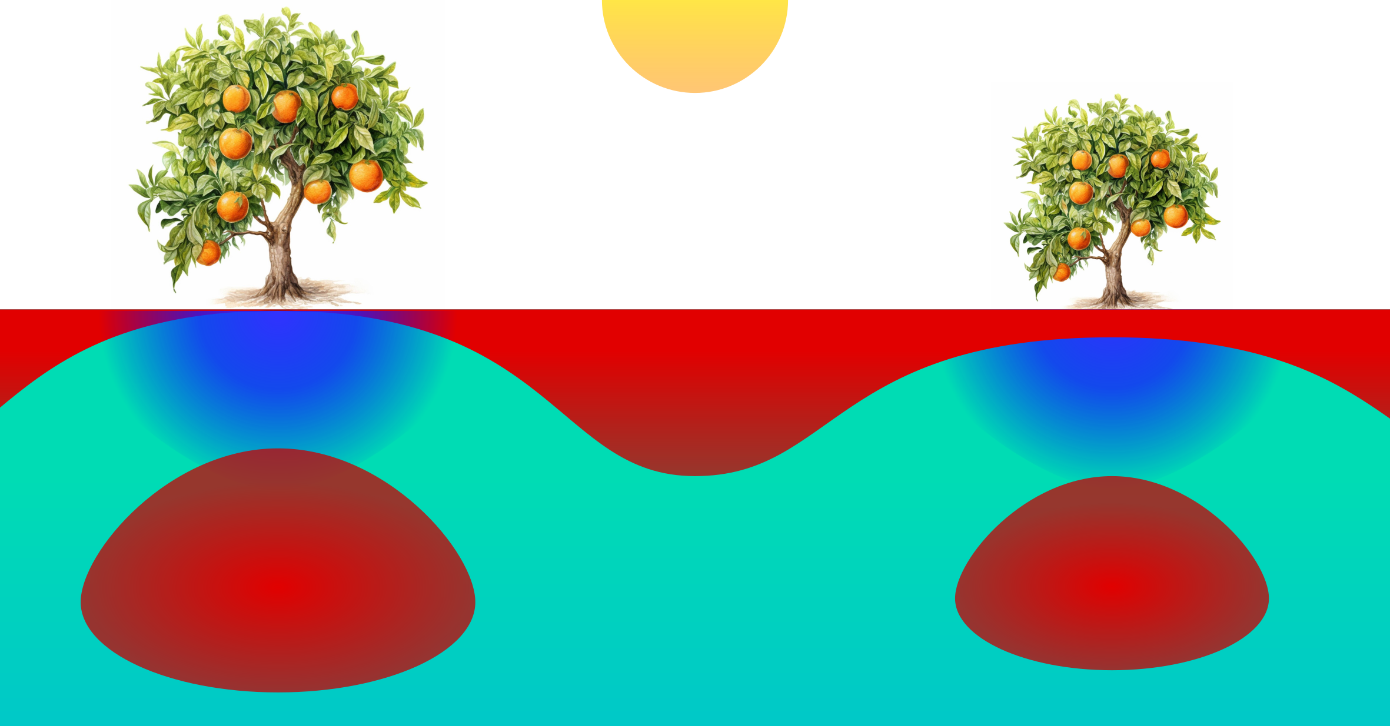

Slide 25
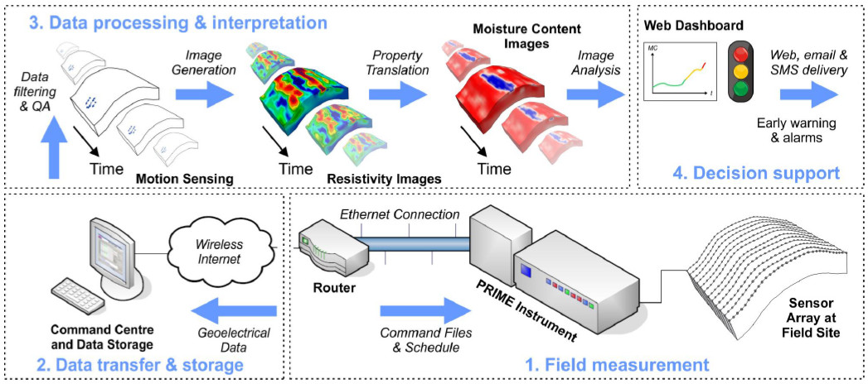

Slide 26
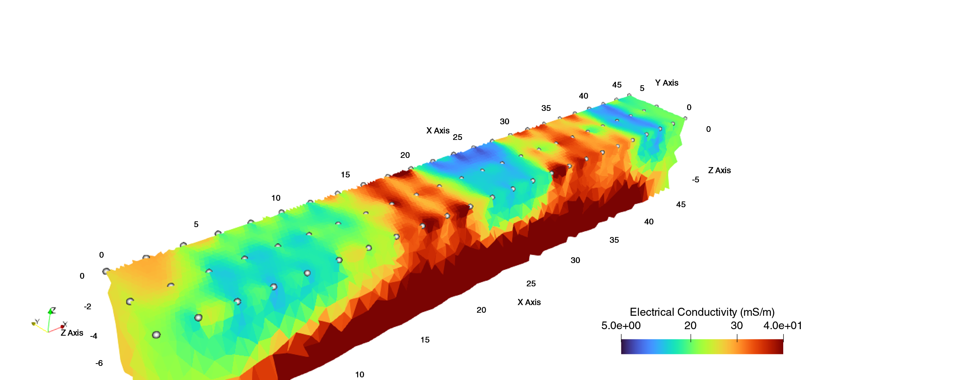
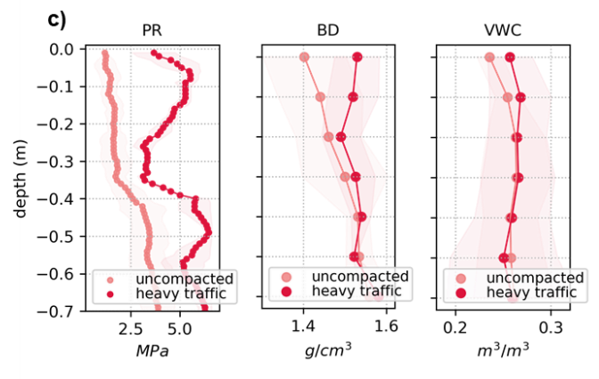
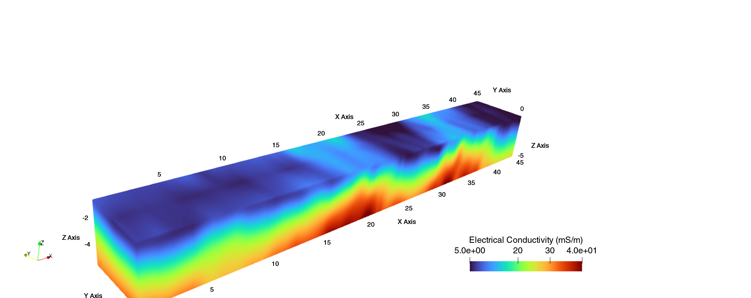
ERT
Traditional methods
FDEM

Slide 27
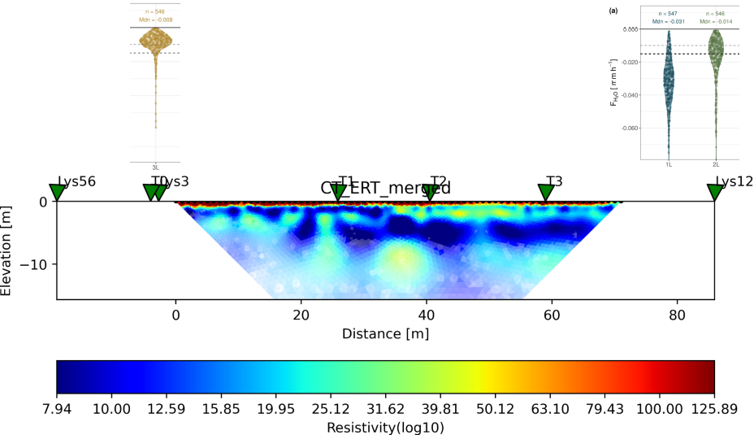

Slide 28
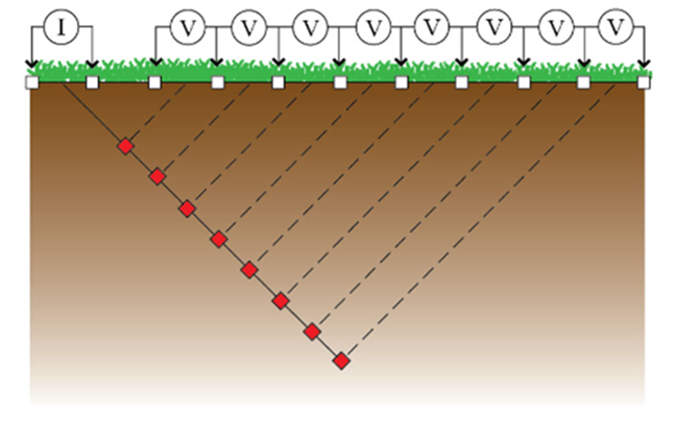


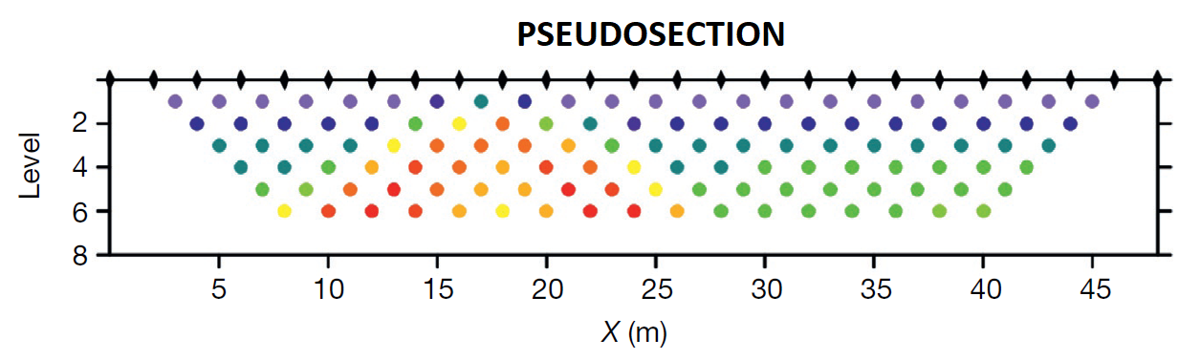
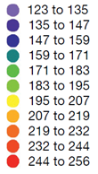
Electrical Resistivity Tomography (ERT)
Current injection I in the ground through a couple of electrodes and potential ΔV measurement by other electrode couples
Data processing of the measured sequence and inversion
Pseudosection
𝜌_{a}(Ω)
Resistivity model
𝜌 (Ωm)
2D or 3D Resistivity
model of the subsoil
6/13

Slide 29
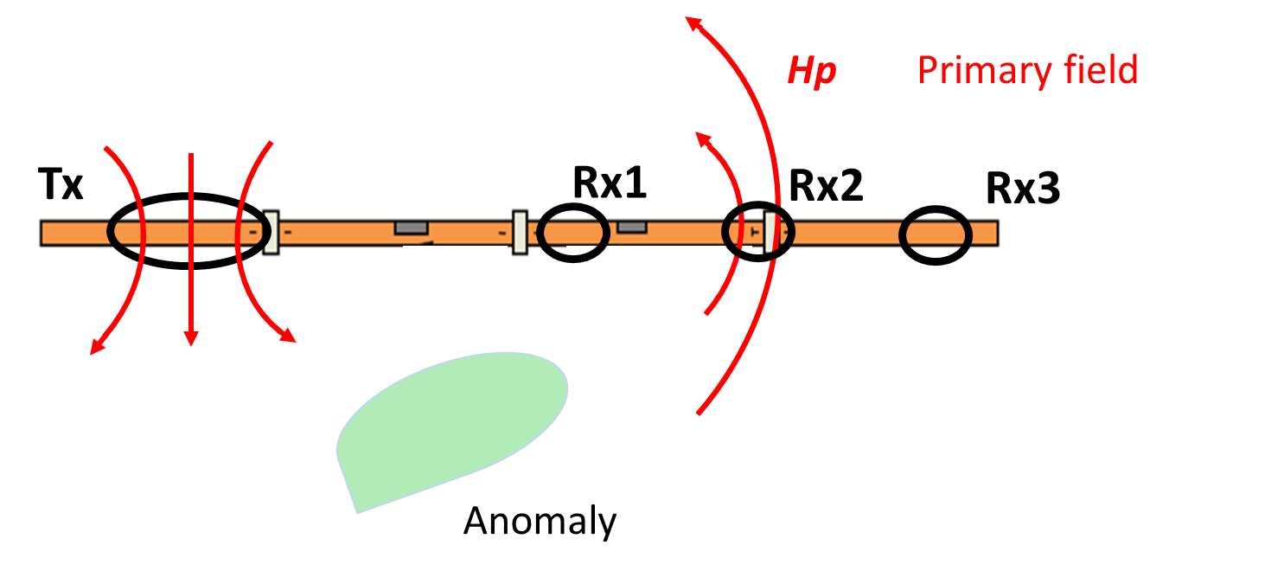
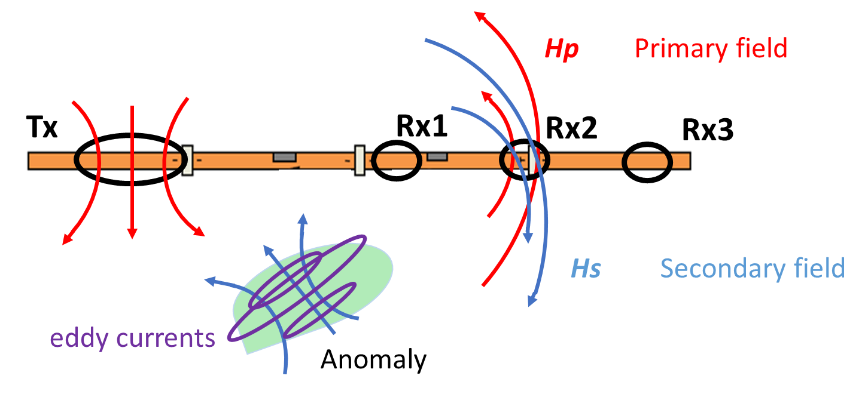
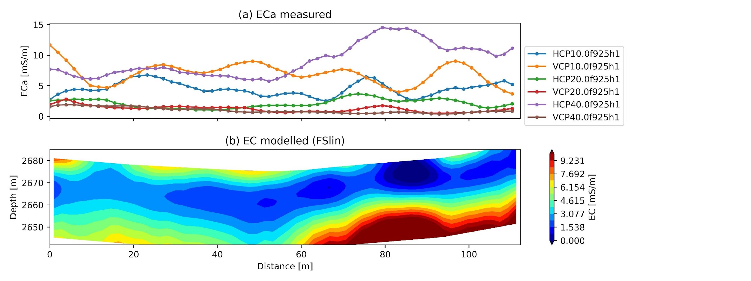
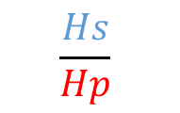
Frequency-Domain Electromagnetic Method (FDEM)
Transmitter antenna Tx generates a primary electromagnetic field (Hp) which propagates in the ground
Receiver antennas Rx register
Secondary electromagnetic field (Hs)
generated in the ground
Measured ECa
1D
inversion
EC model
Conductivity model
of the subsoil
5/13

